Slide 1
Using TABLE MODE to find the coordinates of a function

Slide 2




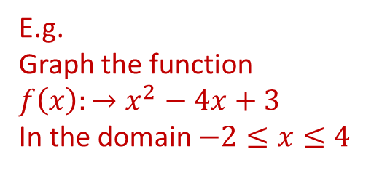
E.g.
Graph the function
$f\left(x\right):→x^{2}−4x+3$
In the domain $−2≤x≤4$
Change the mode of the calculator
Choose Table
Change the mode of the calculator

Slide 3







E.g.
Graph the function
$f\left(x\right):→x^{2}−4x+3$
In the domain $−2≤x≤4$
X is in red
so we need to press Alpha first
Type in the rest of the function
Then press

Slide 4











E.g.
Graph the function
$f\left(x\right):→x^{2}−4x+3$
In the domain $−2≤x≤4$
Our Domain starts at -2
Press
Our Domain ends at 4
Steps: (the interval between the x values) we normally choose 1
Use the down arrow of the cursor to go down the table
Our Coordinates are
(-2 ,15 )
(-1 , 8 )
(0 , 3 )
(1 , 0 )
(2 , -1 )
(3 , 0 )
(4 , 3 )

Slide 5
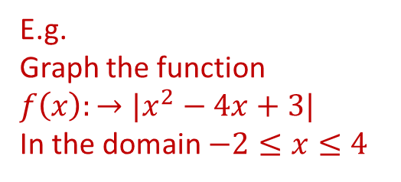
E.g.
Graph the function
$f\left(x\right):→{|x}^{2}−4x+3|$
In the domain $−2≤x≤4$
Change the mode of the calculator
Choose Table
Change the mode of the calculator

Slide 6



We first need to choose Absolute value
E.g.
Graph the function
$f\left(x\right):→{|x}^{2}−4x+3|$
In the domain $−2≤x≤4$
We first need to choose Absolute value
X is in red
so we need to press Alpha first
Type in the rest of the function
Then press

Slide 7


E.g.
Graph the function
$f\left(x\right):→{|x}^{2}−4x+3|$
In the domain $−2≤x≤4$
Our Domain starts at -2
Press
Our Domain ends at 4
Steps: (the interval between the x values) we normally choose 1
Use the down arrow of the cursor to go down the table
Our Coordinates are
(-2 ,15 )
(-1 , 8 )
(0 , 3 )
(1 , 0 )
(2 , 1 )
(3 , 0 )
(4 , 3 )

